Slide 1
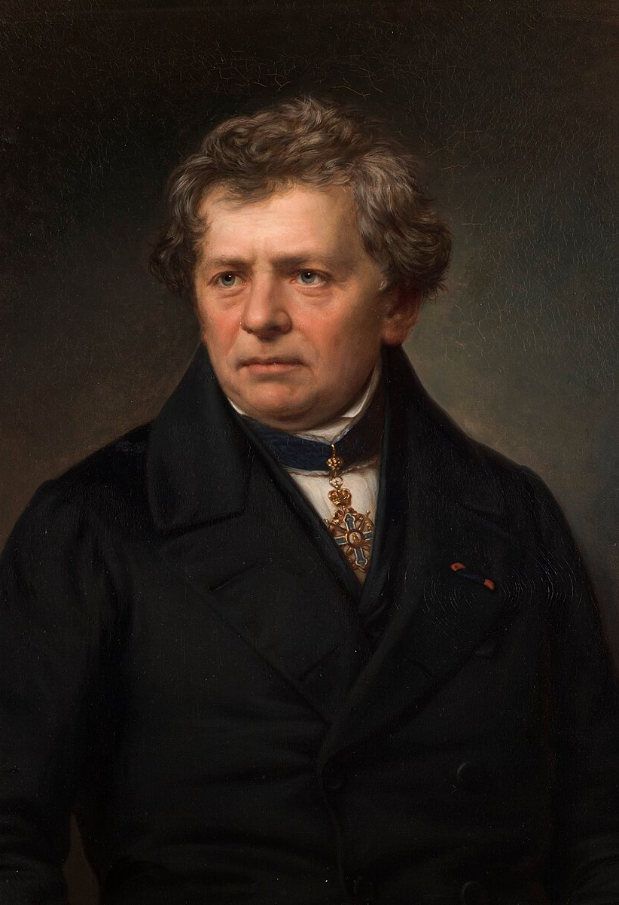
Georg Simon Ohm (1789-1854)
In 1827, Georg Simon Ohm introduced Ohm’s Law, a fundamental principle of electricity.

Slide 2
To Understand Ohm’s Law, First Know Voltage & Current
What is Potential Energy?
Potential energy is the energy stored in a body because of its position or condition.
Example: A ball lifted up gains potential energy because it can fall back down.
Formula (in gravity): PE = mgh
Key idea: When a body moves against a force, it stores energy (potential energy).

Slide 3
Electric Potential :
Similar idea, but instead of gravity, the force is electric force.
Electric potential = Work done to bring 1 unit charge from infinity to a point in an electric field.
It tells us how much energy each unit charge has at that point.
Q+
V = W / Q
Potential Difference (Voltage):
Potential Difference (PD) = Work done to move 1 unit charge from one point to another.
In simple words: It’s the “push” or energy difference that makes charges move in a circuit.
Q+
Current :
It is the rate at which electric charges flow through a conductor.

Slide 4
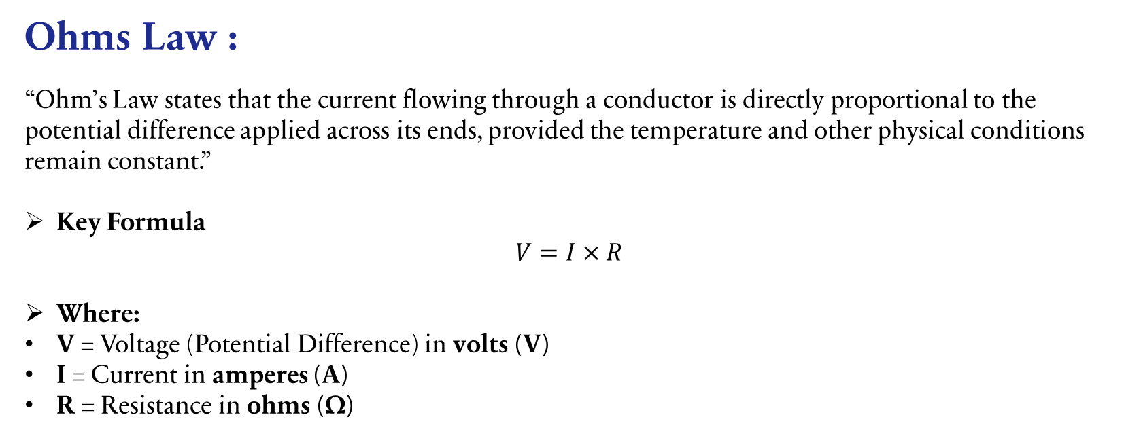
Ohms Law :
“Ohm’s Law states that the current flowing through a conductor is directly proportional to the potential difference applied across its ends, provided the temperature and other physical conditions remain constant.”
Key Formula
$$V=I×R$$
Where:
V = Voltage (Potential Difference) in volts (V)
I = Current in amperes (A)
R = Resistance in ohms (Ω)

Slide 5

🎯 Resistance :
Resistance is the opposition offered by a material to the flow of electric current. It measures how much the material restricts the movement of charges (typically electrons in conductors).
Resistance Formula :
From Ohm's Law, resistance can be calculated as: R = V / I
Important Properties :
Unit: The SI unit of resistance is ohm (Ω), represented by the Greek letter omega
Independence: Resistance value is independent of voltage and current
Dependence factors: Resistance depends on:
Nature of the conductor material
Length of the conductor
Cross-sectional area of the conductor
Temperature and other physical conditions

Slide 6
Graphical Representation of Ohm’s Law”
A
As we know :
slope = dy / dx
Here slope is resistance so,
R = Voltage / Current
Voltage
B
C
Current

Slide 7
Thank you
Munaf Ahmed Khan
03308116985
munafcoder@gmail.com

